Slide 1
Pharmacology of the Cardiovascular System
Hyperlipidaemia
Ken Wojcikowski

Slide 2
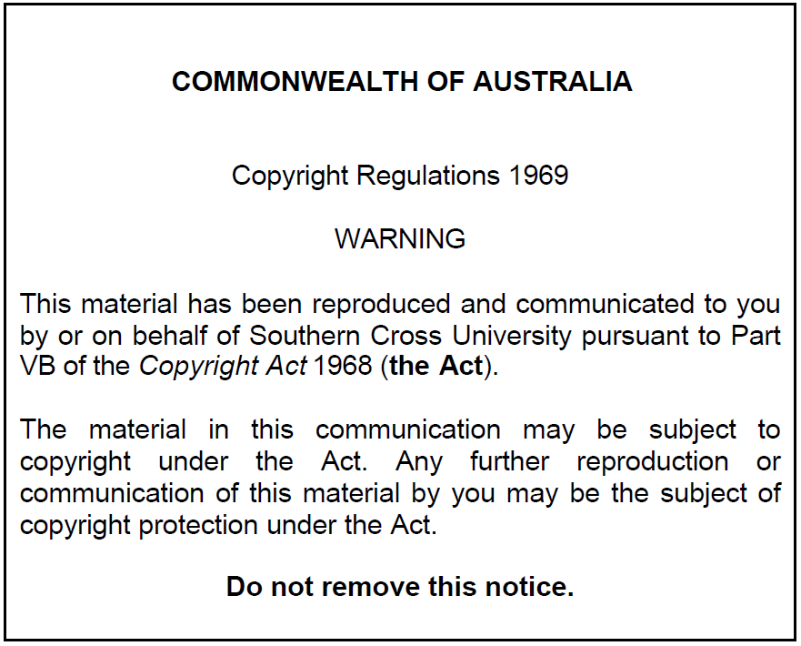
Pharmacology of the Cardiovascular System:
Hyperlipidaemia
Dr Ken Wojcikowski

Slide 3
PHAR2001_2_5_1
kjhkjhlkdfs
Medications of the Cardiovascular System: Medications for Altering Lipid Levels
Lesson 1:
Understanding Lipids

Slide 4
Objectives for the first three lessons
Define the terms hyperlipidaemia, dyslipidaemia, HDL and LDL
Describe atherosclerosis, including the risk factors, and potential consequences of plaques on the arteries

Slide 5
Lipids
Tri(acyl)glycerides
  Used in energy metabolism
    ONE glycerol and three fatty acids
Phospholipids
  Important structural constituents of lipoproteins, blood- clotting components, the myelin sheath, and cell membranes
Cholesterol
  Chemical activity similar to other lipid substances
Hyperlipidaemia
  Elevated levels of one or all of the above

Slide 6
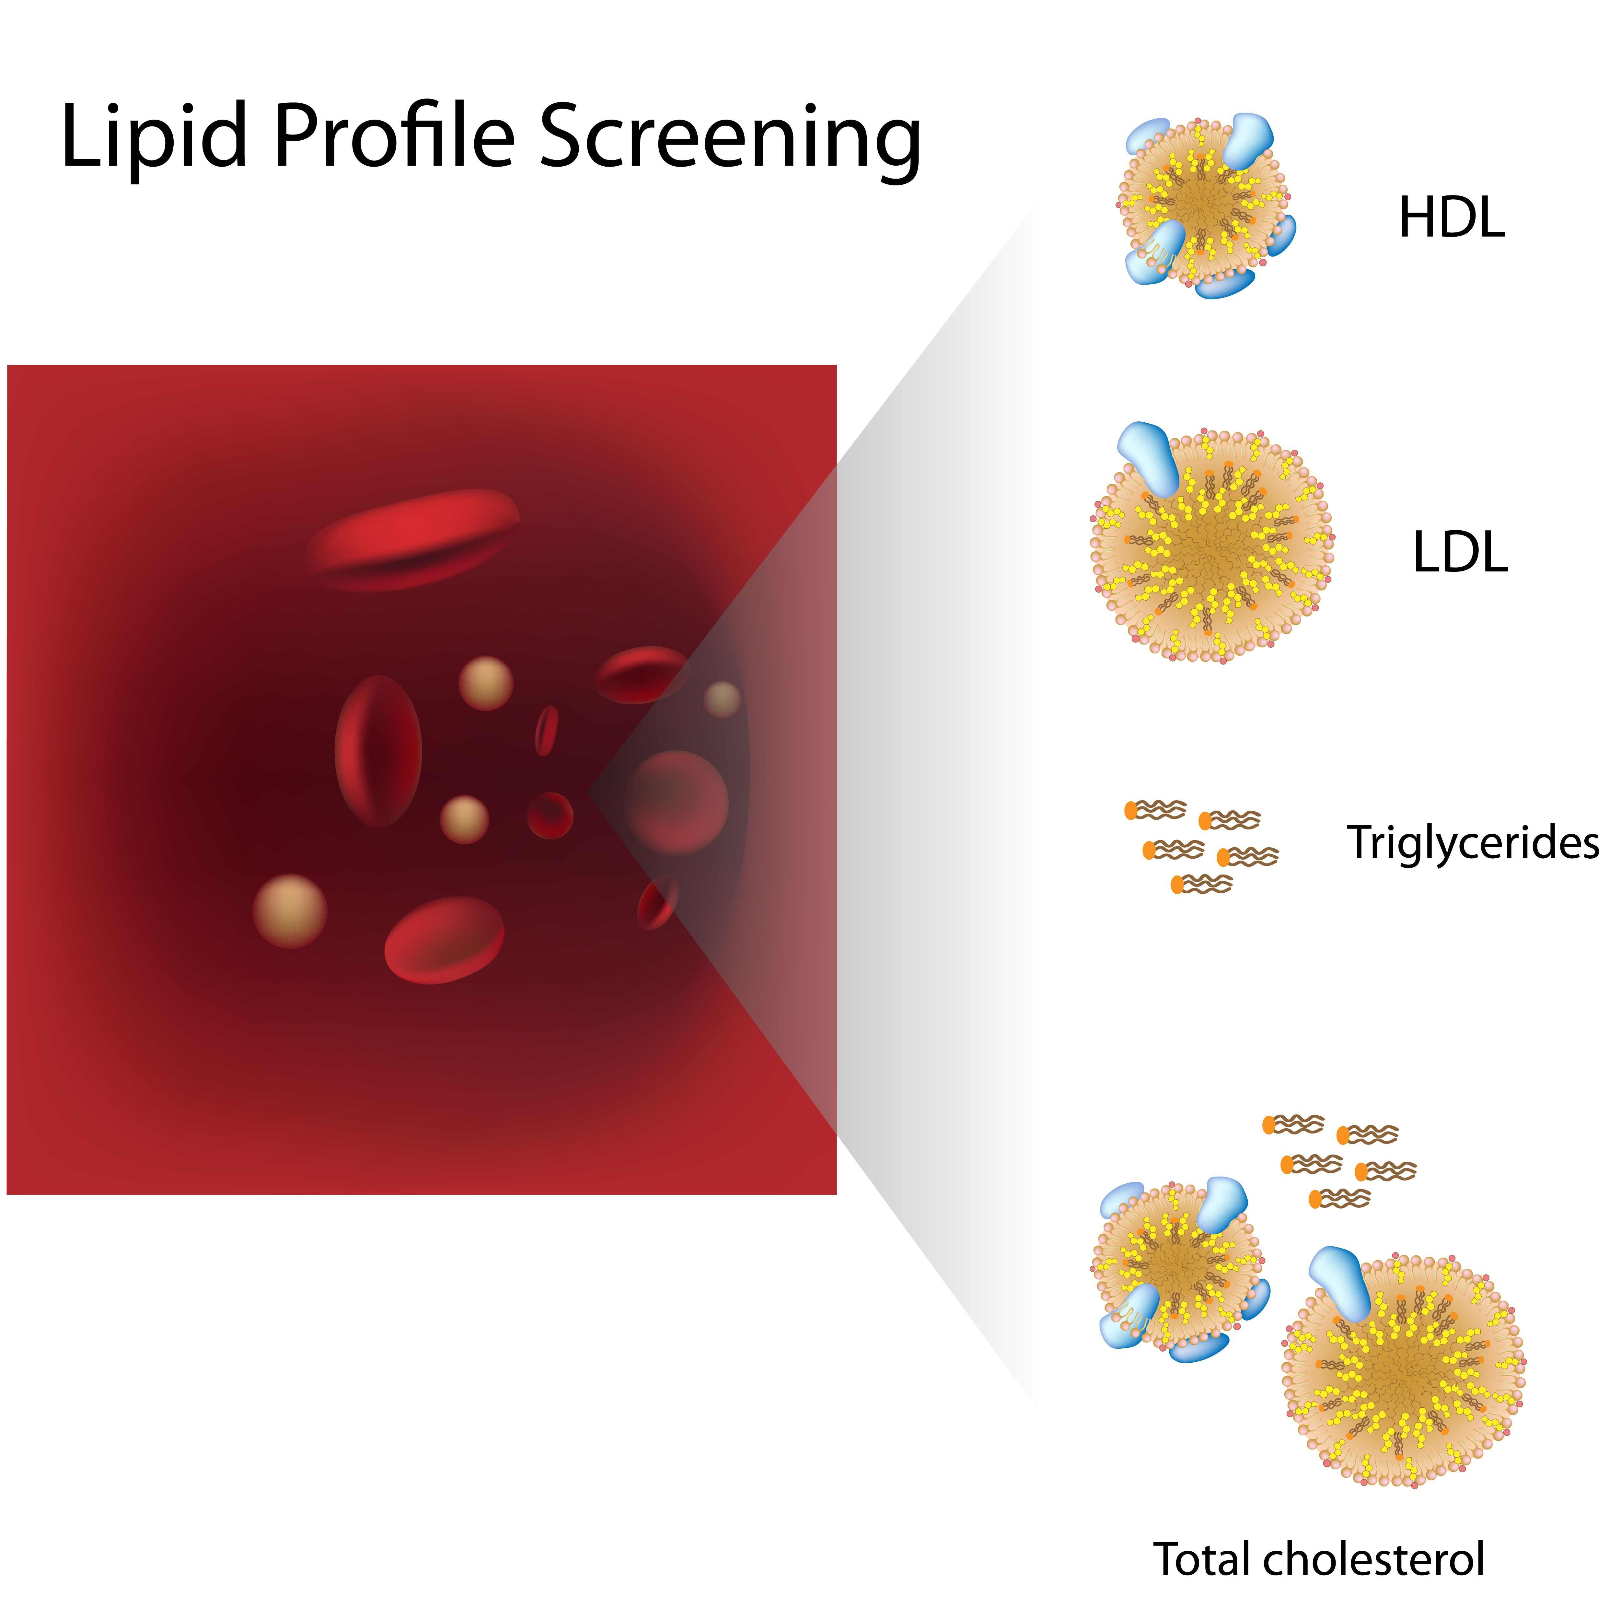
Types of Lipoproteins;
Classified by Density
Chylomicrons (transfer lipids from GIT to liver)
Very–low-density lipoprotein (VLDL)
  Carries large amounts of triglycerides
Intermediate-density lipoprotein (IDL)
Low-density lipoprotein (LDL)
  Main carrier of cholesterol from the liver to the cells
High-density lipoprotein (HDL)
  The good protein
Schematic drawing of HDL, a protein

Slide 7
The common lipid profile screening includes:
HDL: a protein
LDL: a protein
Triglycerides: a type of fat
Total Cholesterol: both HDL and LDL

Slide 8
Dyslipidaemia/hyperlipidaemia
Virtually synonymous
  High levels of lipids in the blood (but dyslipidaemia may also describe low amounts of HDL)
    Secondary hyperlipidaemia (caused by multiple risk factors)
    Primary/familial hypercholesterolemia
    Primary/familial hypertriglyceridemia
Lipid | NORMAL Blood level
LDL (Bad) HDL (Good) Cholesterol Triglycerides | <2.0 mmol/L >1.0 mmol/L <4.0 mmol/L <1.5 mmol/L

Slide 9
PHAR2001_2_5_1
kjhkjhlkdfs
Medications of the Cardiovascular System:
Medications for Altering Lipid Levels
Lesson 2:
Understanding Atherosclerosis

Slide 10
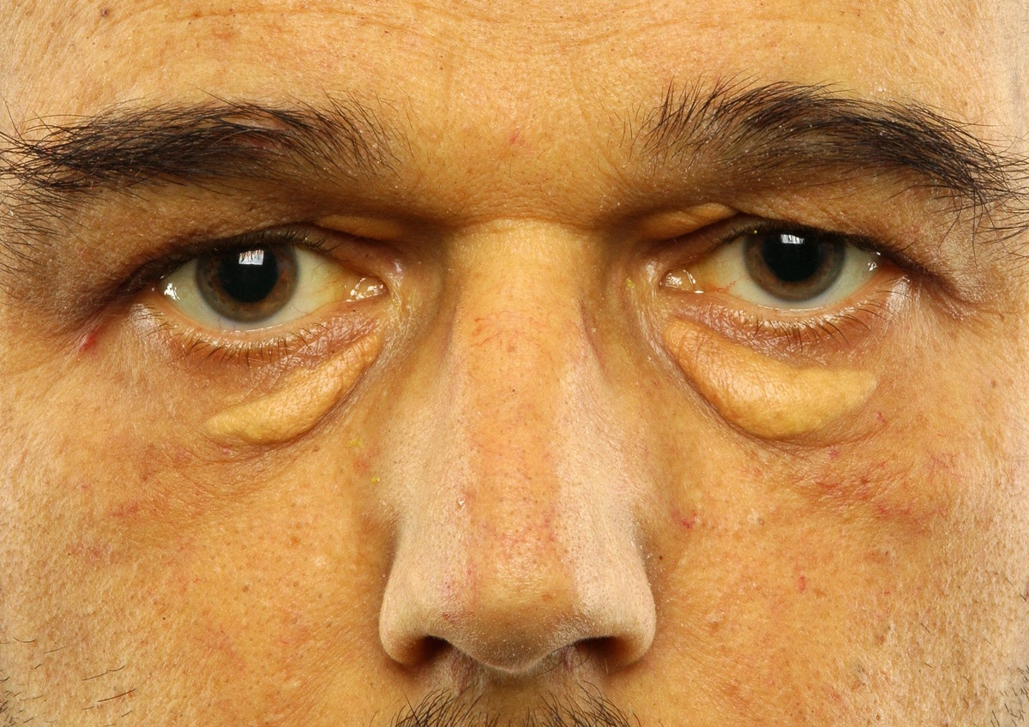
Xanthelasma
http://cosmetic-mole-surgery.com/cosmetic-treatments/

Slide 11
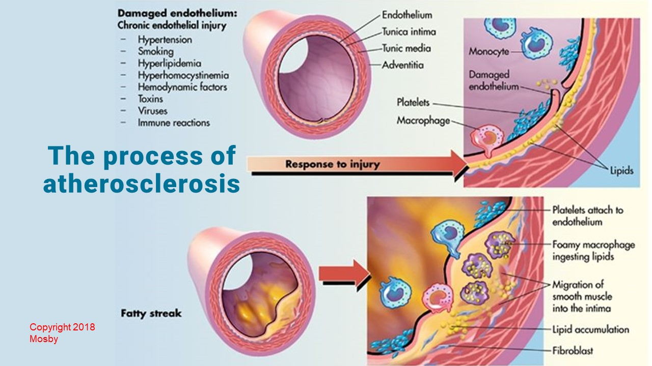
Copyright 2018 Mosby

Slide 12
PHAR2001_2_5_1
kjhkjhlkdfs
Medications of the Cardiovascular System:
Medications for Altering Lipid Levels
Lesson 3:
Understanding Atherosclerosis (cont.)

Slide 13
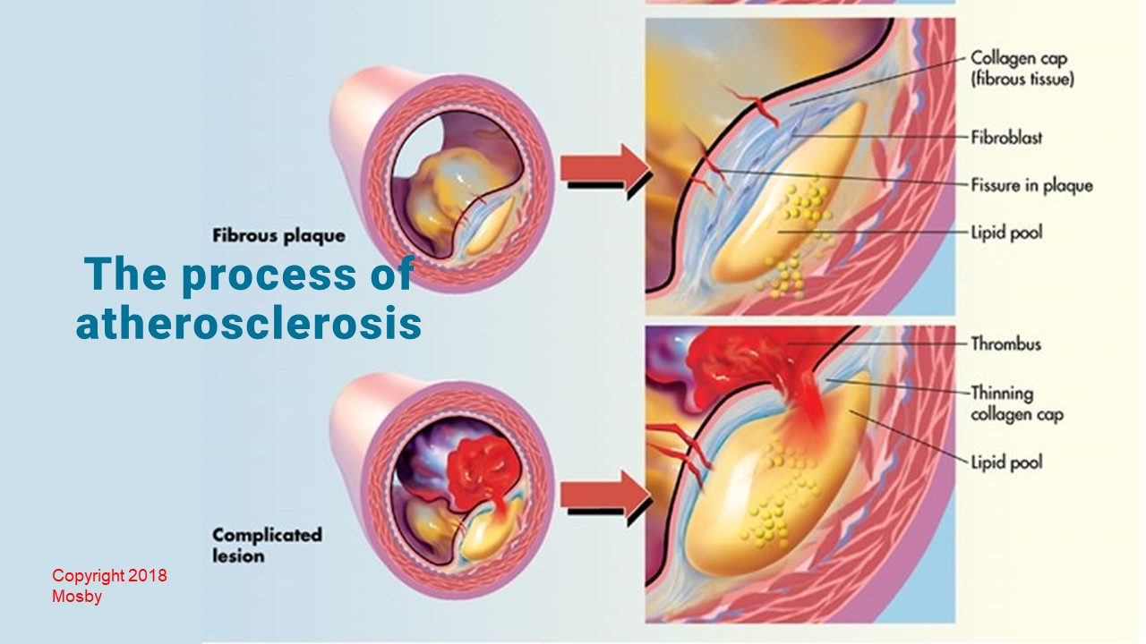
Copyright 2018 Mosby

Slide 14
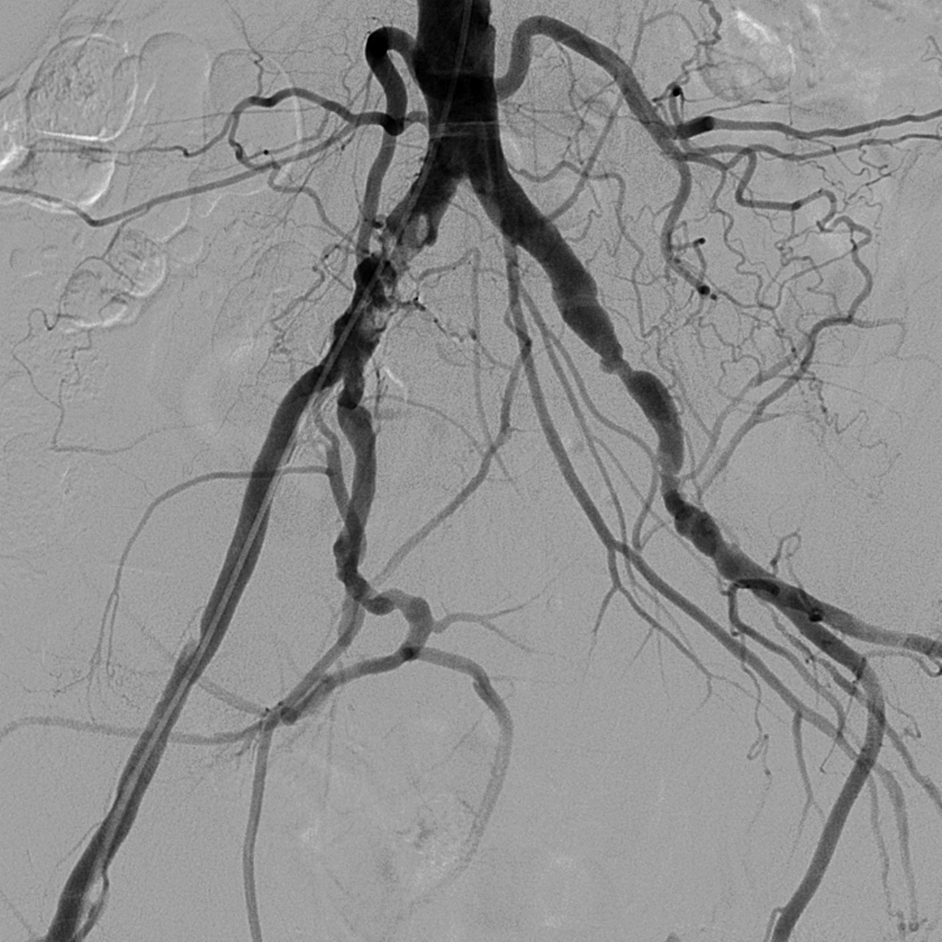

Slide 15
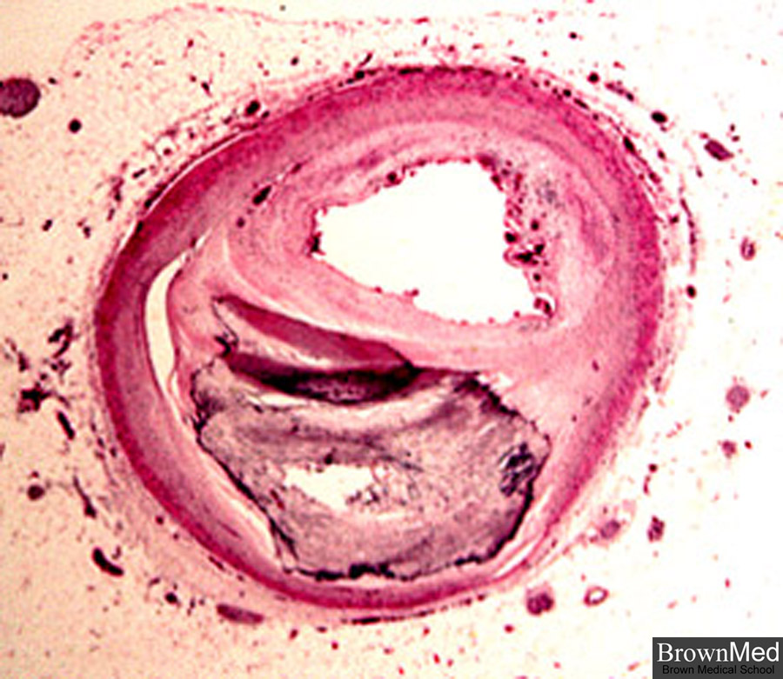
Atherosclerosis of the Coronary Artery

Slide 16
Pharmacology of the Cardiovascular System
Hyperlipidaemia Medications
Ken Wojcikowski

Slide 17
Objective the remaining lessons
Identify and describe the therapeutic actions and major side effects of common pharmacological agents used in the treatment of dyslipidaemia or hyperlipidaemia.

Slide 18
PHAR2001_2_5_1
kjhkjhlkdfs
Medications of the Cardiovascular System:
Medications for Altering Lipid Levels
Lesson 4:
HMG-CoA reductase inhibitors (the statins)

Slide 19
HMG-CoA reductase inhibitors (the statins)
All end in the suffix …statin
  Atorvastatin (Lipitor),
  Simvastatin (Zocor, Simvar)
  Lovastatin (Mevacor)
  HMG-CoA reductase is the enzyme that the liver uses to make cholesterol
BONUS!: They also have anti-inflammatory and antithrombotic effects, stabilising plaques and preventing their rupture and increase longevity

Slide 20

HMG-CoA reductase inhibitors (the statins)
    Adverse effects:
    GI disturbances,
    Possible rhabdomyolysis (rare, but may cause acute renal failure, so be aware of this!)
      Tea coloured urine and muscle soreness are the first signs
    Contraindications:
    Pregnancy Category D
    Liver disease

Slide 21
HMG-CoA reductase inhibitors (the statins)
  Check recent evidence before prescribing one statin over the other
  These do vary greatly in efficacy and the one that is associated with the greatest increase in longevity in recent studies should be chosen (unless the safety profile makes it inappropriate)!
  Not to be used by women of reproductive years
  Do not use in liver damage
  Monitor Liver Function Test (LFT) in all patients
  Raised AST and ALT means liver damage

Slide 22
PHAR2001_2_5_1
kjhkjhlkdfs
Medications of the Cardiovascular System:
Medications for Altering Lipid Levels
Lesson 5:
Medications that affect the absorption and excretion of cholesterol

Slide 23
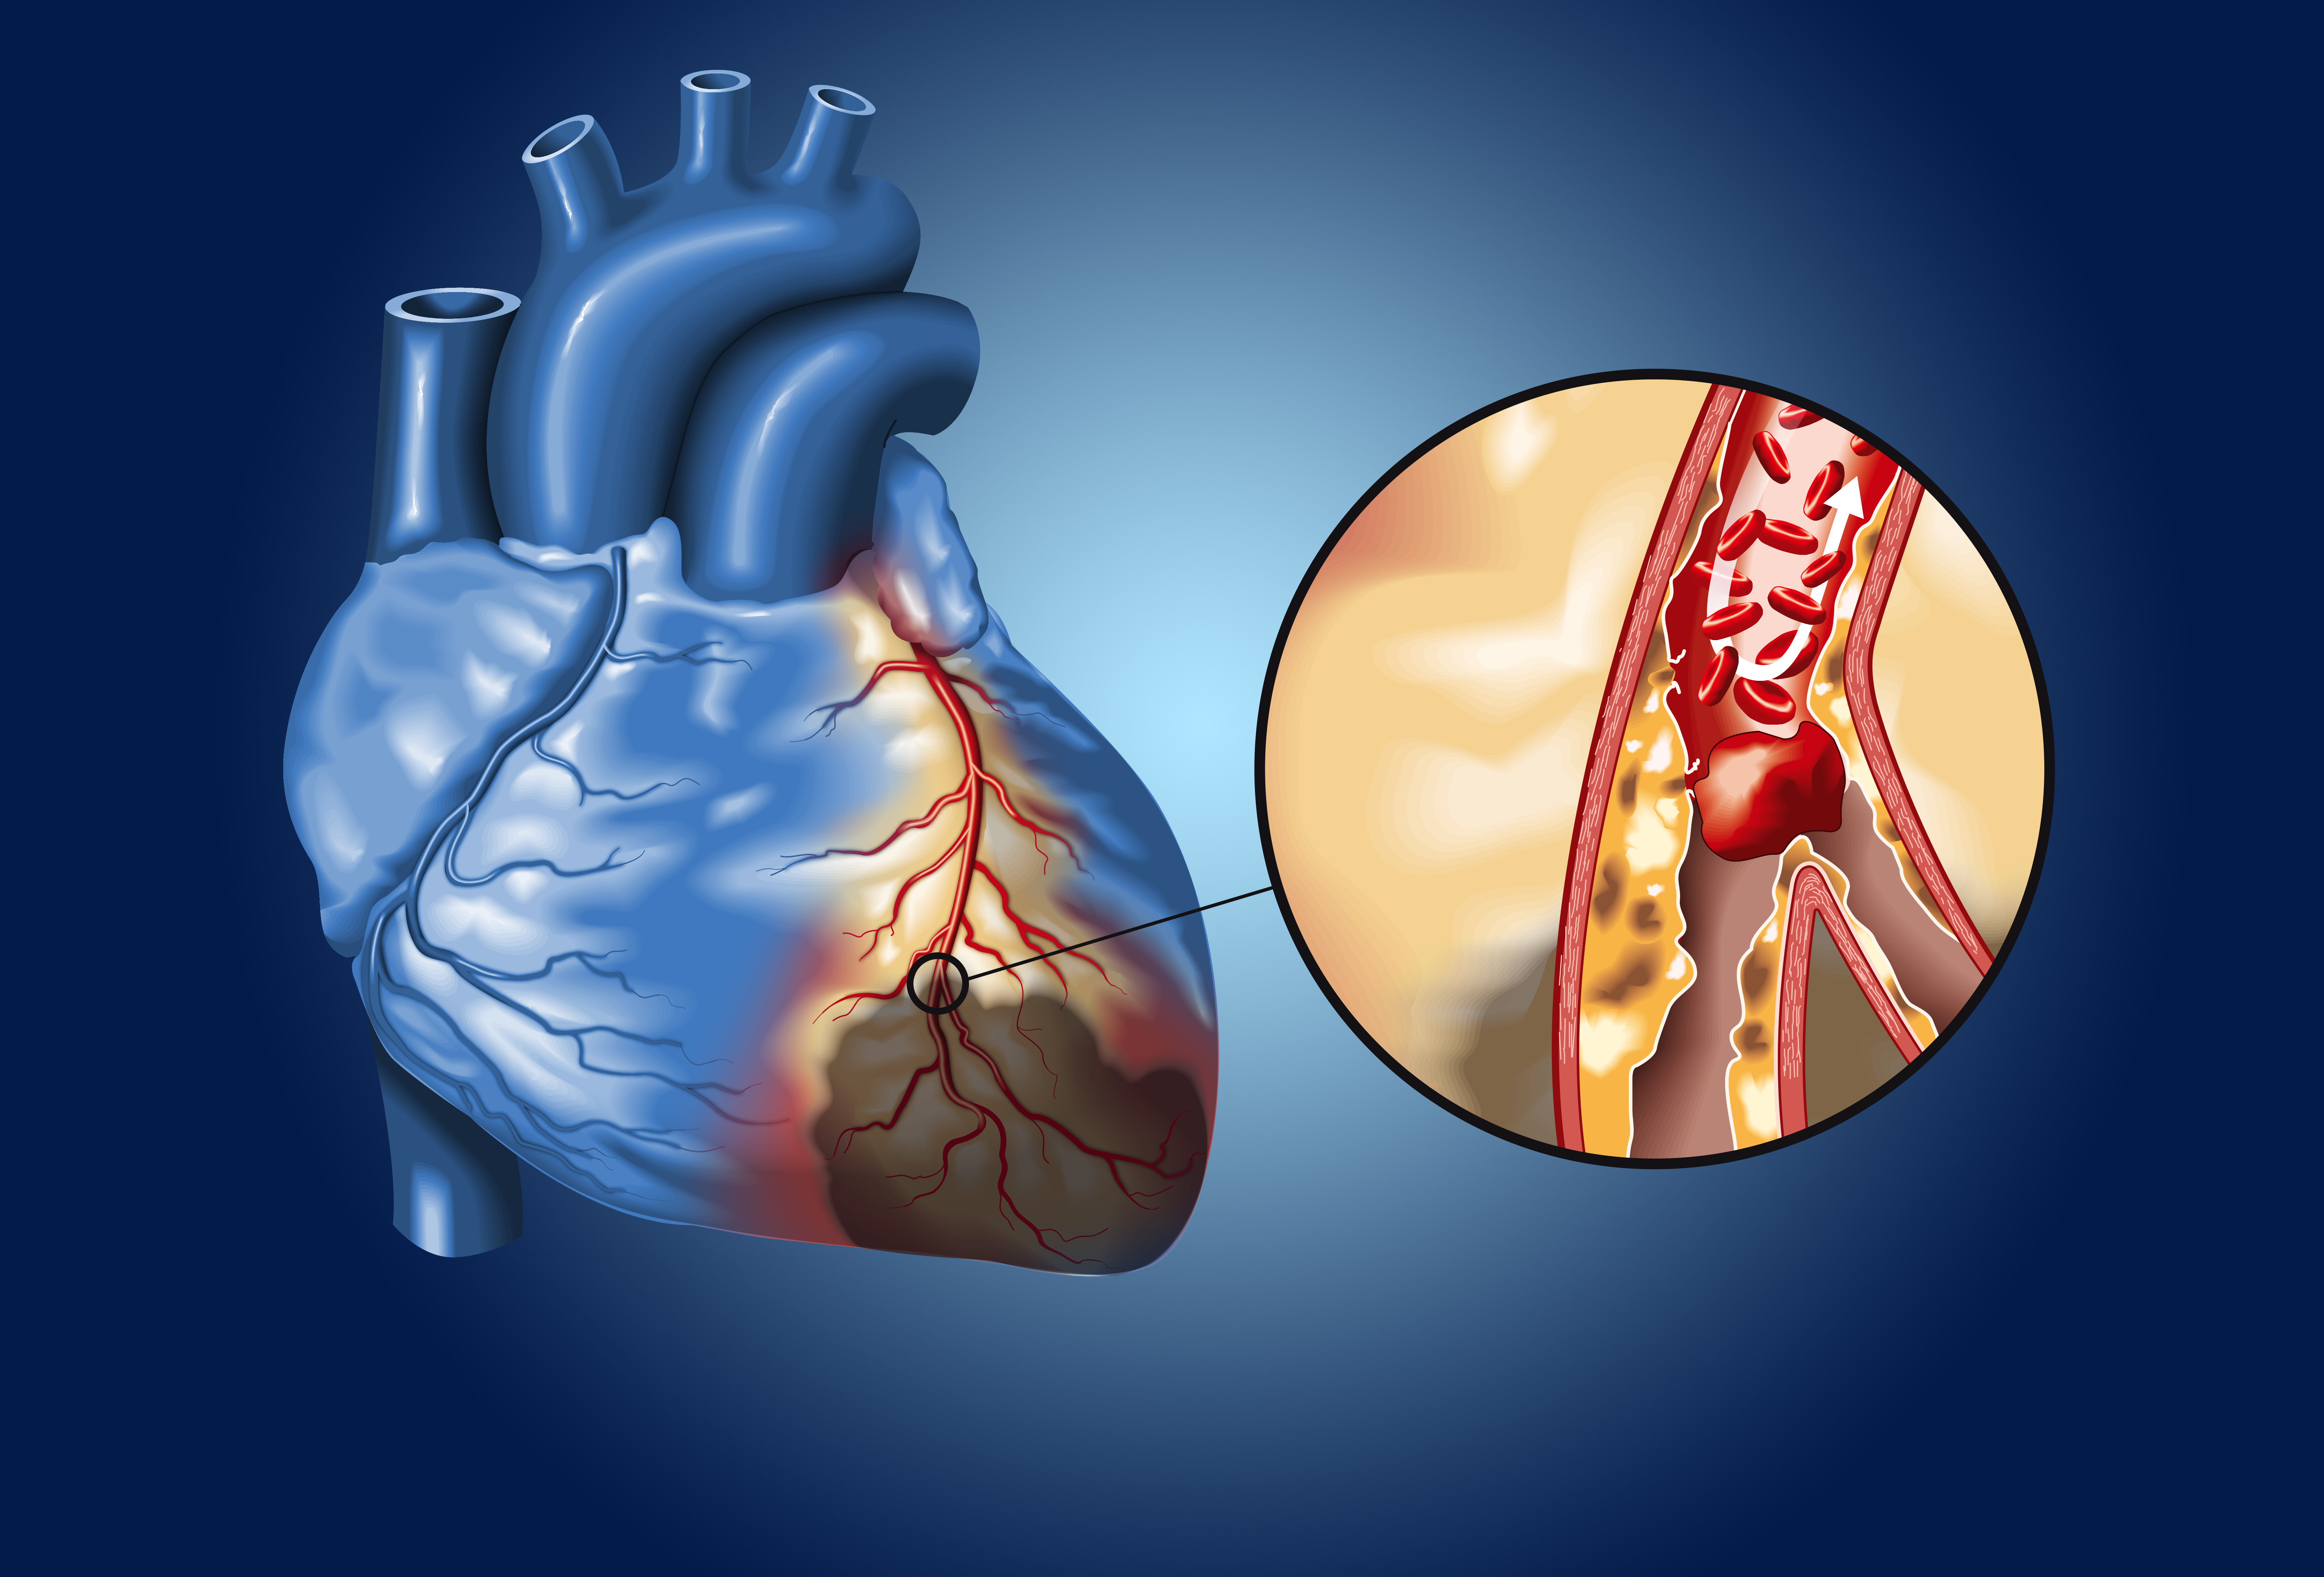
Cholesterol absorption inhibitors
Cholesterol absorption inhibitors (relatively new)
  Ezetimibe (Ezetrol) eh zet im ib
    Limit absorption of cholesterol in the small intestines
    Liver increases uptake of systemic cholesterol
    Adverse effects: GI disturbances
Unlike most other combinations of lipid normalising medications, Ezetimibe can be combined with statins
  Most other combinations of lipid lowering drugs are contraindicated

Slide 24
Bile acid sequestrants
  Cholestyramine (Questran) chole steera meen
  Like Styrofoam – sucks up the bile salts in the small intestines
    Bile salts excreted instead of reused
  The initial decreases in LDL may be negated by the liver
  The medication tastes terrible
  The medication binds fat soluble vitamins, D, K, E and A
  The medication causes constipation

Slide 25
Bile acid sequestrants
  Cholestyramine (Questran)
  Contraindications:
  pregnancy (decrease the absorption of fats and fat soluble vitamins; babies need fats and fat soluble vitamins);
  do not consume with any drugs as it may decrease absorption
  Good news – it is useful in decreasing the diarrhea associated with Crohn’s disease and along with antibiotic therapy in treatment of GIT Clostridium infections (binds the toxins and decreases the diarrhea)

Slide 26
PHAR2001_2_5_1
kjhkjhlkdfs
Medications of the Cardiovascular System:
Medications for Altering Lipid Levels
Lesson 6:
Nicotinic Acid

Slide 27
Nicotinic acid
Vitamin B3; (Niaspan)
  Huge dose of nicotinic acid (1-3 grams daily)
  Decreases formation of free fatty acids in adipose tissue
  Not suitable in all types of hyperlipidaemia, but can decrease triglycerides by 25%
  Decreases LDL and increases HDL by 30%
Not to be used in
  Liver disease, Diabetes mellitus,
  Gout or Stomach ulcers

Slide 28

Nicotinic acid
Adverse effects include flushing of the ears and face, pruritus, GIT ulcers, nausea, diarrhoea, heartburn, and possible hypotension
  May need to start off with small dose to reduce flushing
  To reduce flushing: Titrate dose, take just after meals, or suggest an aspirin 30 minutes prior
Nicotinic acid not to be taken with
  Statins
  Fibrates
Flushing/ (burning feeling) of the ears is a common side effect

Slide 29
PHAR2001_2_5_1
kjhkjhlkdfs
Medications of the Cardiovascular System:
Medications for Altering Lipid Levels
Lesson 7:
Fibrates

Slide 30
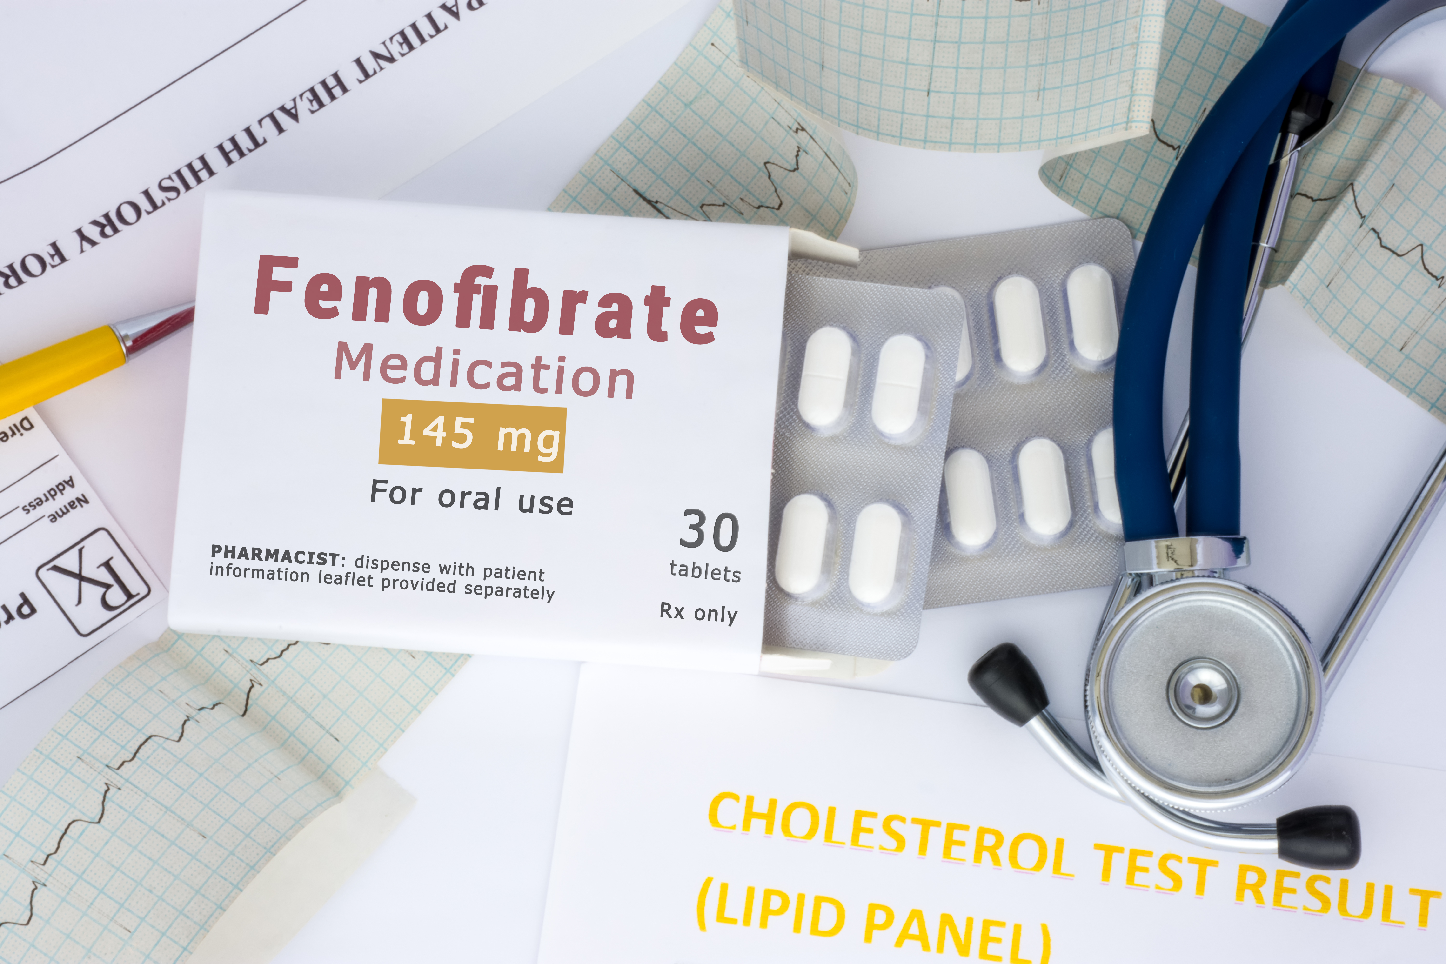
Fibrates
Largely superseded by statins and other newer medicines
Increase the breakdown of lipids in tissues
  Fenofibrate (Lipidil; the example to know)
LDL sometimes rises but is partially offset by increases in HDL, an inhibition of platelet aggregation and an increase in fibrinolysis

Slide 31
Fibrates
Adverse effects:
  Abdominal pain, nausea, diarrhoea
  Myalgia (muscle pain) may be the first symptom of rhabdomyolysis
  Gall stones
Individuals should be advised to speak to their doctor if they experience muscle pain, weakness and tenderness as these signs may be indicative of myalgia rhabdomyolysis, not myalgia)
Contraindicated in those taking:
  Warfarin
  Statins
  Nicotinic Acid

Slide 32
PHAR2001_2_5_1
kjhkjhlkdfs
Medications of the Cardiovascular System:
Medications for Altering Lipid Levels
Lesson 8:
Special notes about lipid lowering drugs

Slide 33
Special notes about lipid lowering drugs
Always ‘monitor the liver’ when giving hypercholesterolaemic drugs
  How? The Liver Function Test (LFT, specific enzymes AST, ALT)
Most combinations of lipid lowering drugs are contraindicated
  Exception to the rule: Ezetimibe can be combined with statins
None of the lipid normalizing drugs are ideal during pregnancy.
  At one time statins were thought to be teratogenic but are now listed as pregnancy category D
  In addition, babies need cholesterol !!!!!!!!!!
  Dietary approaches are more suitable than drugs during pregnancy if that is possible (those with familial hypercholesterolemia do not respond to lifestyle changes very well).

Slide 34
.
References
McCance K, Huether S: Pathophysiology: The biological basis for disease in adults and children 8th ed. Mosby St Louis 2018
Marieb EN et al. Human Anatomy and Physiology 6th ed. Pearson Education publishing as Benjamin Cummings 2004
Thibodeau G: Anatomy and physiology 5th ed Mosby St. Louis 2003
http://cosmetic-mole-surgery.com/cosmetic-treatments/
Royalty free images from Shutterstock
The PowerPoint and associated Video were edited and produced by Dr. Ken Wojcikowski

